Slide 1
new advances in aquaculture

Slide 2
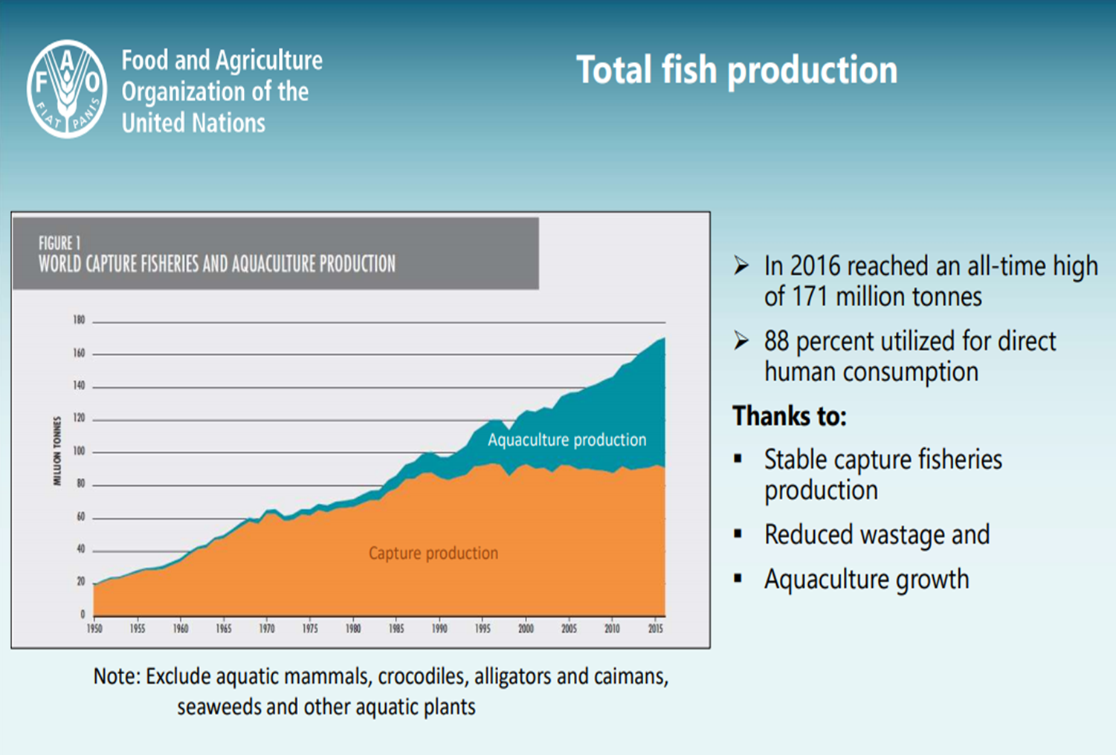
AQUACULTURE
Definition: Farming of aquatic organisms, including fish, molluscs, crustaceans and aquatic plants, in any type of aquatic environment
Fastest growing food sector in the world
Around 5oo species in production worldwide

Slide 3
challenges in near future..
Growth of aquaculture production will continue
Major part of aquatic products consumed will come from aquaculture
Challanges in future:
Conflicts related to the use of water and land
Feed and seed avaliability
Interaction with the environment
Disease prevention and treatments
Development and adaptation of the improved technologies for farming
Marketing and adverstising
Tracebility, certification and product security
Adaptation to the global climate changes
Capital investments

Slide 4
course overview: new advances in aqaculture
The course will provide students with knowledge and information on recent technological developments, introduction of new species, recent changes and global trends in aquaculture industry.
The course focus is on the most important technological innovations in the recent years, used in the production technologies for the new species, as well as the production of well - recognised species (such as salmon, sea bass, carp and tilapia) with the use of new technological and/or management tools.
Practical work on fish and bivalve farm and on recilculation hatchery

Slide 5
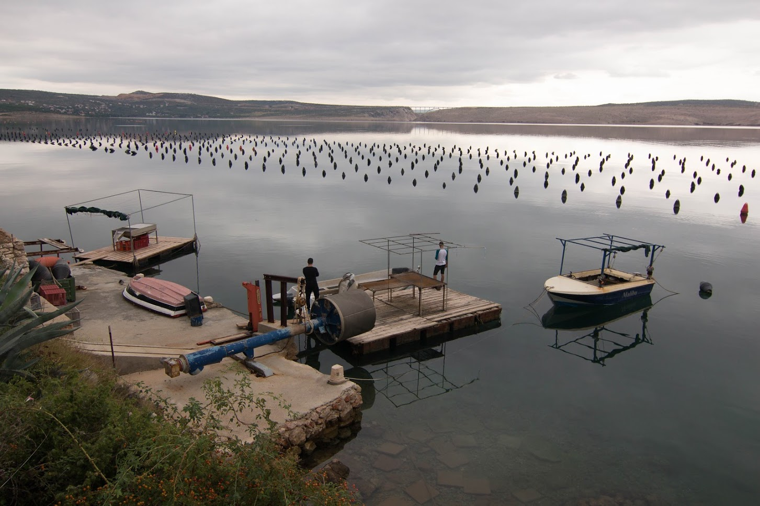
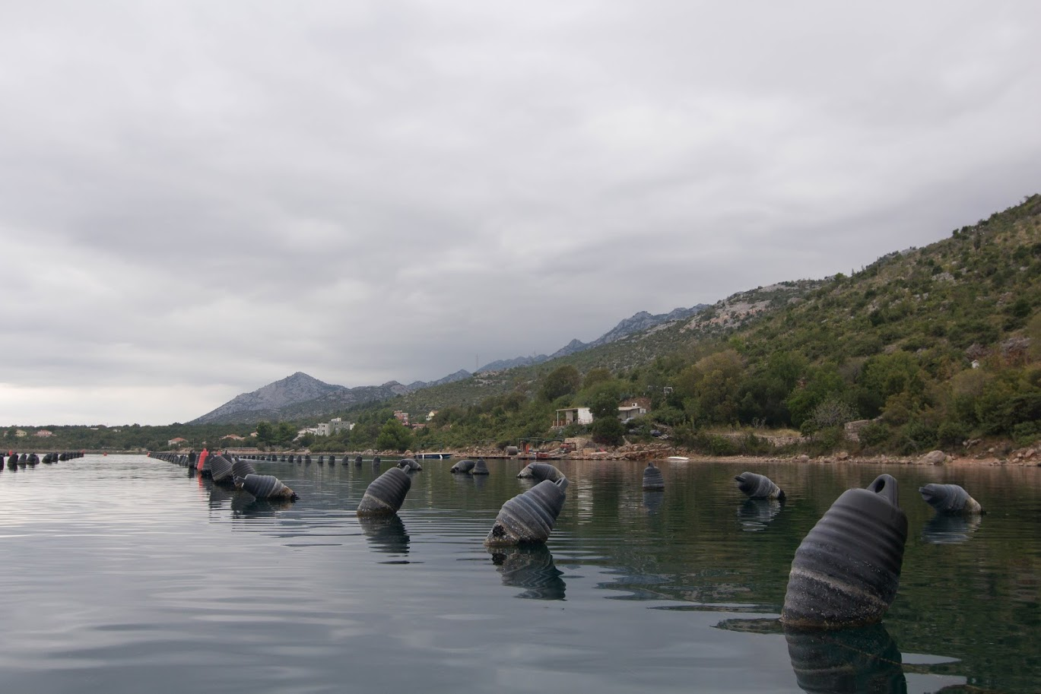

Slide 6
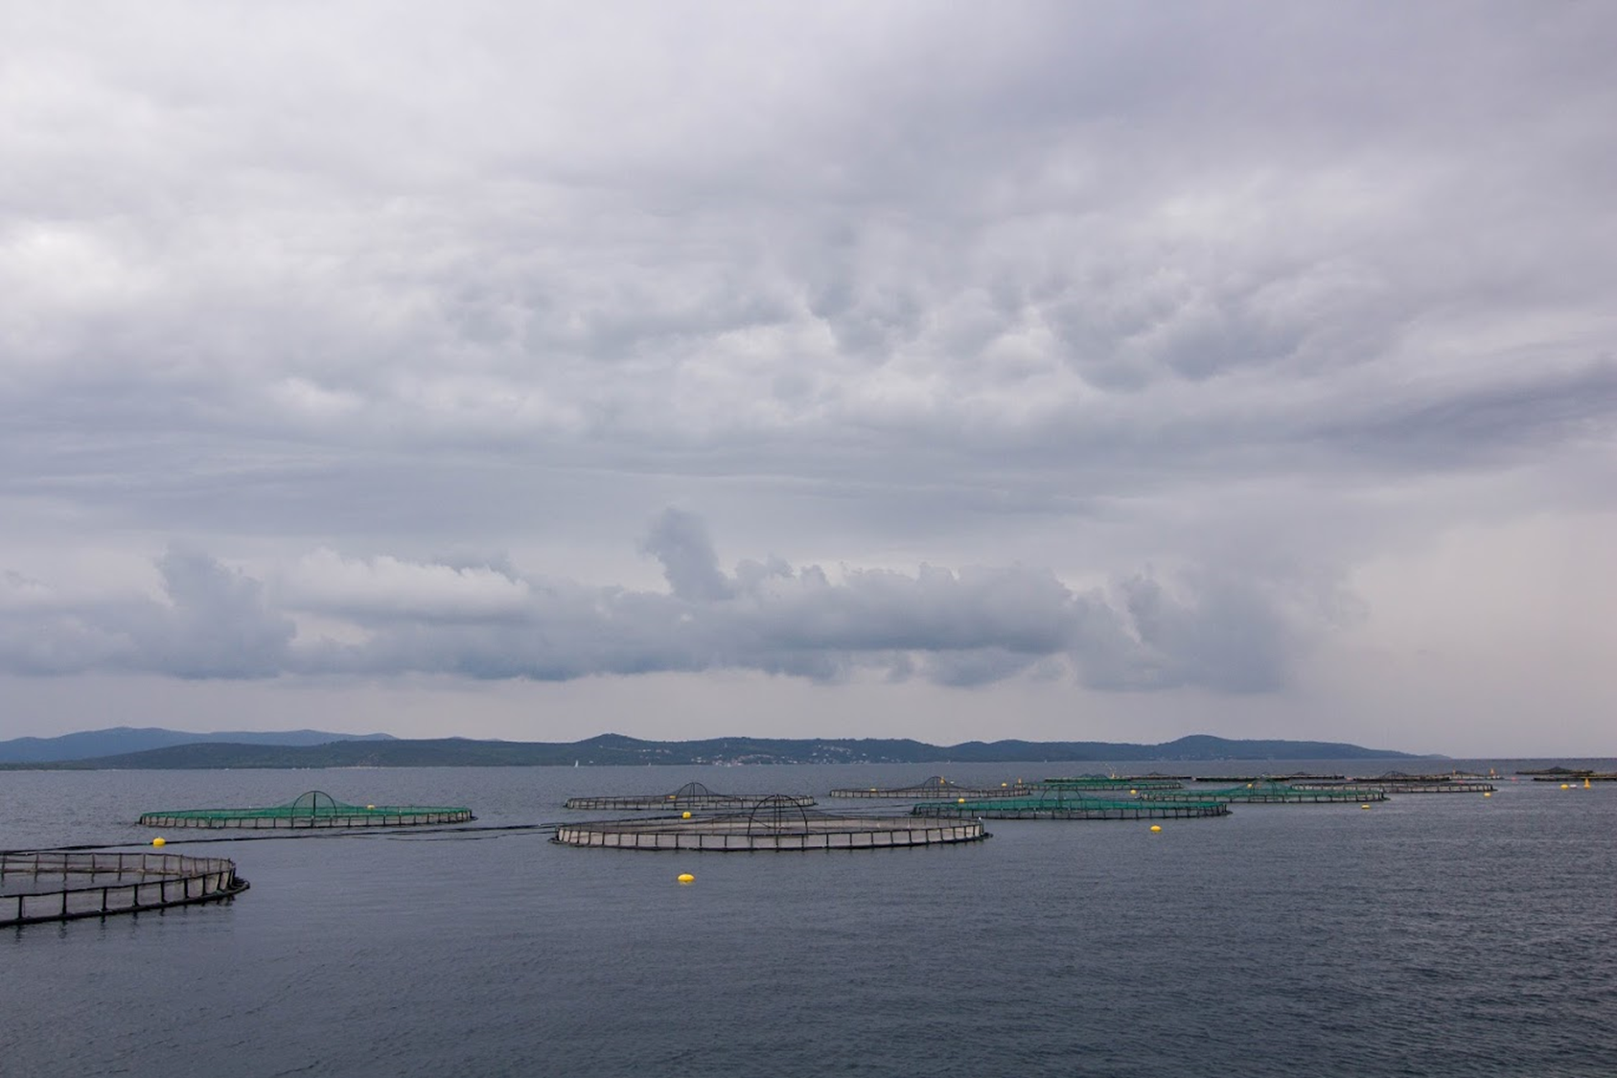
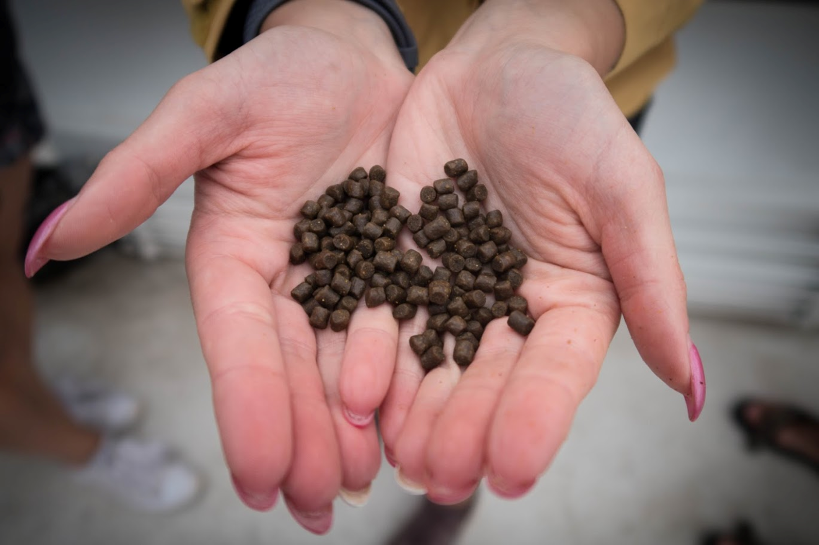

Slide 7
